Slide 1
Recursion

Slide 2
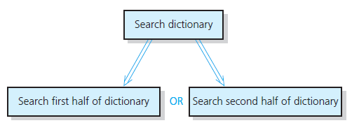
Recursive Solutions
Recursion breaks problem into smaller identical problems
  An alternative to iteration
A recursive solution

Slide 3
Recursive Solutions
A recursive function calls itself
Each recursive call solves an identical, but smaller, problem
Test for base case enables recursive calls to stop
Eventually, one of smaller problems must be the base case

Slide 4
Recursive Solutions
Questions for constructing recursive solutions
How to define the problem in terms of a smaller problem of same type?
How does each recursive call diminish the size of the problem?
What instance of problem can serve as base case?
As problem size diminishes, will you reach base case?

Slide 5
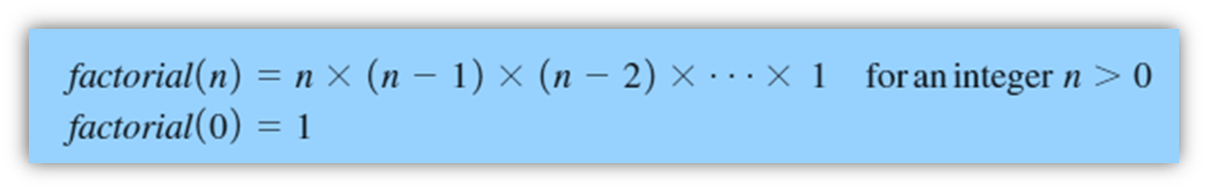
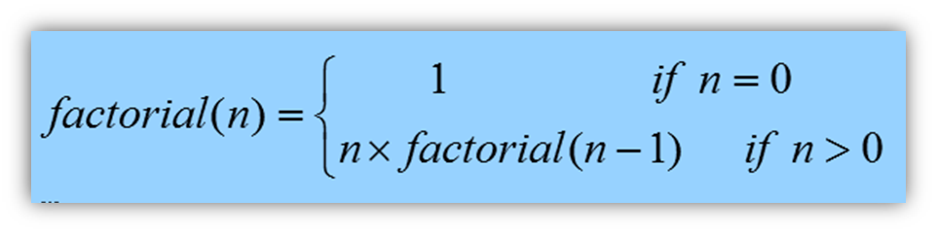
A Recursive Valued Function:
The Factorial of n
An iterative solution
A factorial solution
Note: Do not use
recursion if a
problem has a
simple, efficient
iterative solution

Slide 6
The Box Trace
Label each recursive call
Represent each call to function by a new box
Draw arrow from box that makes call to newly created box
After you create new box executing body of function
On exiting function, cross off current box and follow its arrow back

Slide 7
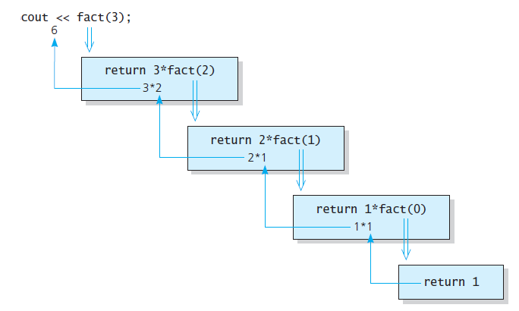
A Recursive Valued Function:
The Factorial of n
fact(3)

Slide 8
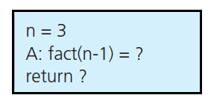
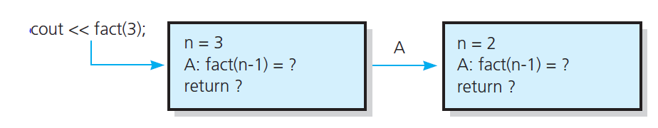
The Box Trace
A box
The beginning of the box trace

Slide 9
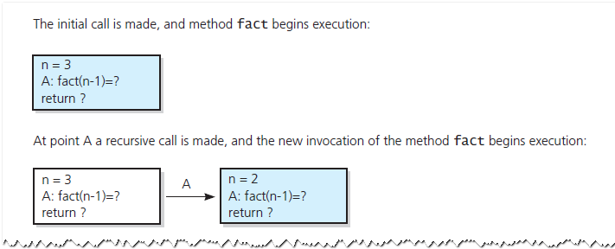
The Box Trace
Box trace of fact(3)

Slide 10
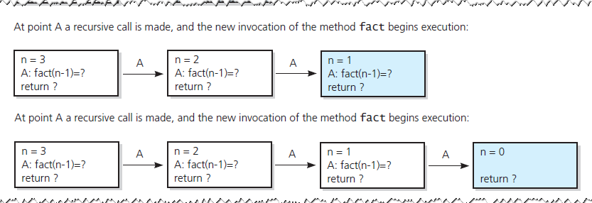
The Box Trace
Box trace of fact(3)

Slide 11
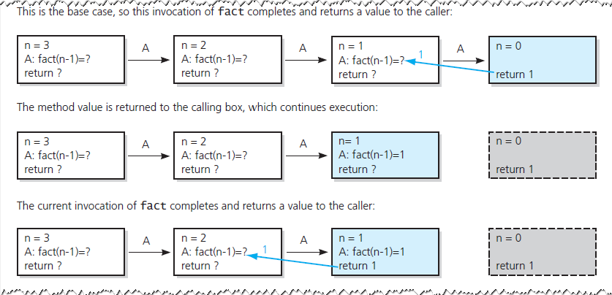
The Box Trace
Box trace of fact(3)

Slide 12
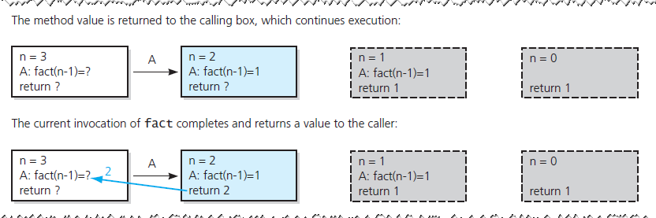
The Box Trace
Box trace of fact(3)

Slide 13
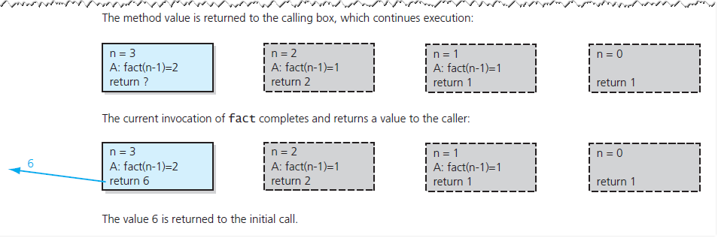
The Box Trace
Box trace of fact(3)

Slide 14
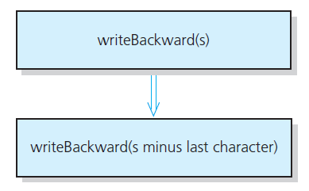
A Recursive Void Function:
Writing a String Backward
Likely candidate for minor task is writing a single character.
  Possible solution: strip away the last character
A recursive solution

Slide 15
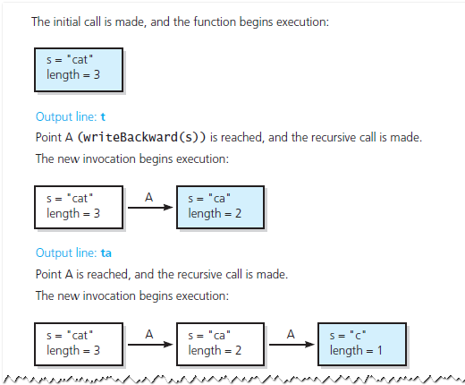
A Recursive Void Function:
Writing a String Backward
Box trace of writeBackward("cat")

Slide 16
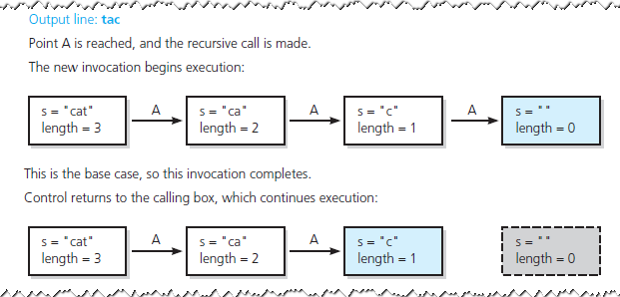
A Recursive Void Function:
Writing a String Backward
Box trace of writeBackward("cat")

Slide 17
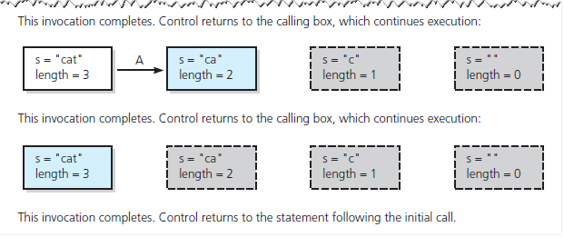
A Recursive Void Function:
Writing a String Backward
Box trace of writeBackward("cat")

Slide 18
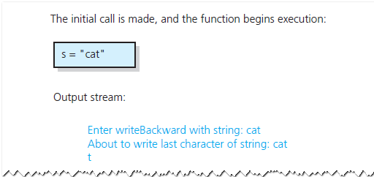
A Recursive Void Function:
Writing a String Backward
Another possible solution
  Strip away the first character
Box trace of writeBackward("cat") in pseudocode
Notes:
This version uses diagnostic output to help trace/understand the algorithm as executed.

Slide 19
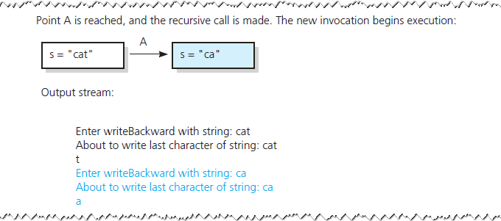
A Recursive Void Function:
Writing a String Backward
Box trace of writeBackward("cat") in pseudocode

Slide 20
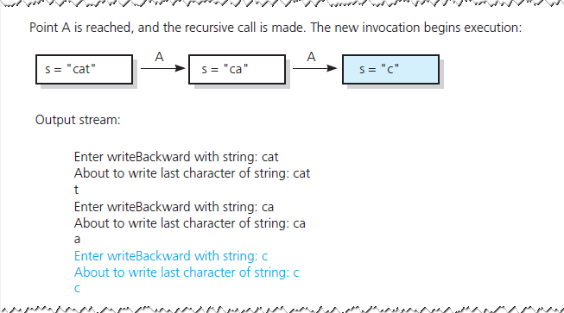
A Recursive Void Function:
Writing a String Backward
Box trace of writeBackward("cat") in pseudocode

Slide 21
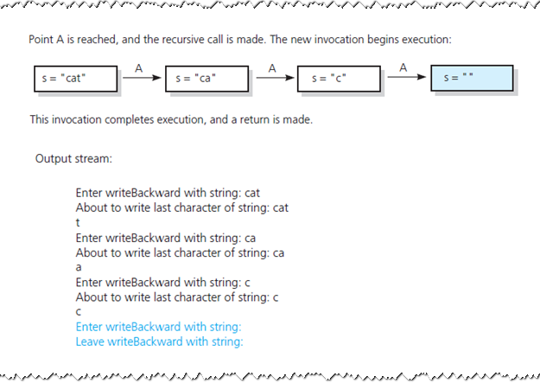
A Recursive Void Function:
Writing a String Backward
Box trace of writeBackward("cat") in pseudocode

Slide 22
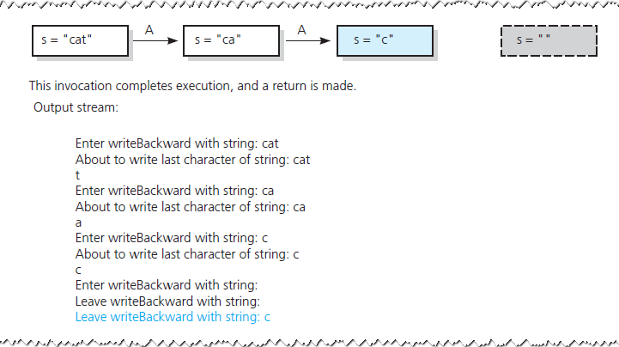
A Recursive Void Function:
Writing a String Backward
Box trace of writeBackward("cat") in pseudocode

Slide 23
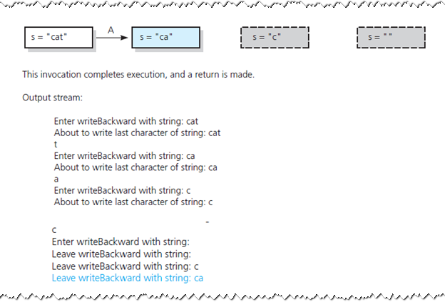
A Recursive Void Function:
Writing a String Backward
Box trace of writeBackward("cat") in pseudocode

Slide 24
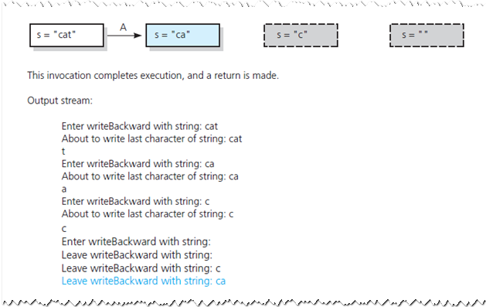
A Recursive Void Function:
Writing a String Backward
Box trace of writeBackward("cat") in pseudocode

Slide 25
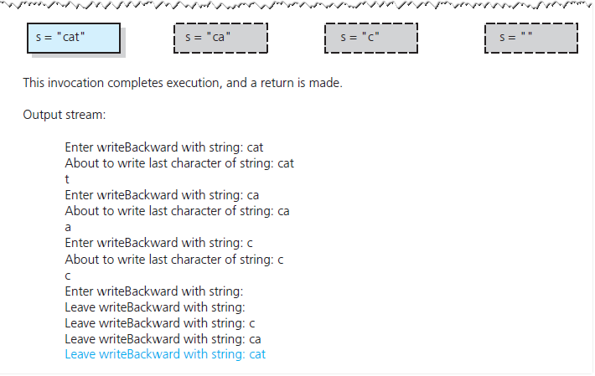
A Recursive Void Function:
Writing a String Backward
Box trace of writeBackward("cat") in pseudocode

Slide 26
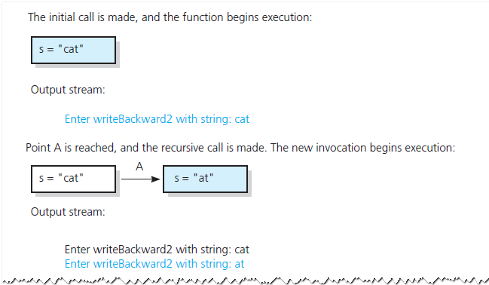
A Recursive Void Function:
Writing a String Backward
Box trace of writeBackward2("cat") in pseudocode

Slide 27
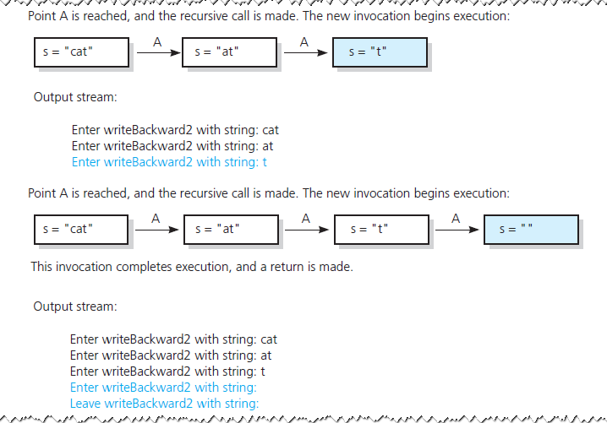
A Recursive Void Function:
Writing a String Backward
Box trace of writeBackward2("cat") in pseudocode

Slide 28
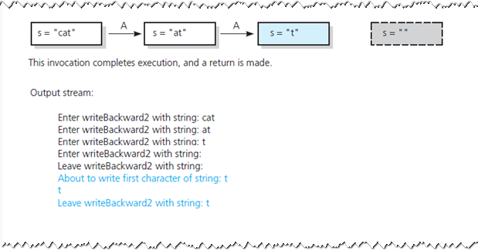
A Recursive Void Function:
Writing a String Backward
Box trace of writeBackward2("cat") in pseudocode

Slide 29
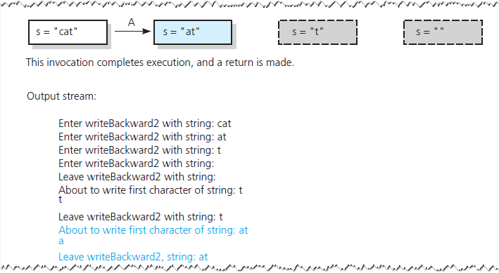
A Recursive Void Function:
Writing a String Backward
Box trace of writeBackward2("cat") in pseudocode

Slide 30
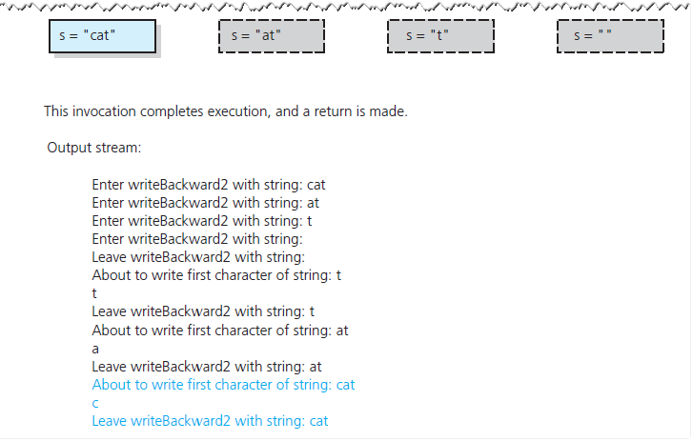
A Recursive Void Function:
Writing a String Backward
Box trace of writeBackward2("cat") in pseudocode

Slide 31
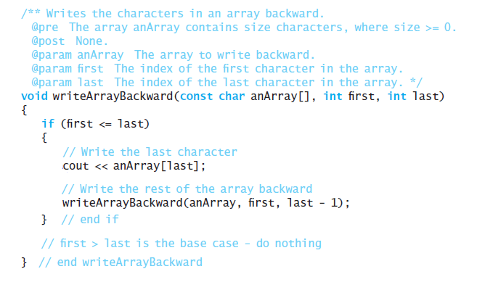
Writing an Array’s Entries in Backward Order
The function writeArrayBackward

Slide 32
The Binary Search
Consider details before implementing algorithm:
How to pass half of anArray to recursive calls of binarySearch ?
How to determine which half of array contains target?
What should base case(s) be?
How will binarySearch indicate result of search?

Slide 33
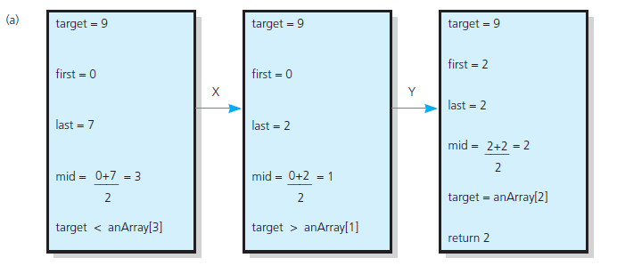
The Binary Search
Box traces of binarySearch with anArray = <1, 5, 9, 12, 15, 21, 29, 31>: (a) a successful search for 9;

Slide 34
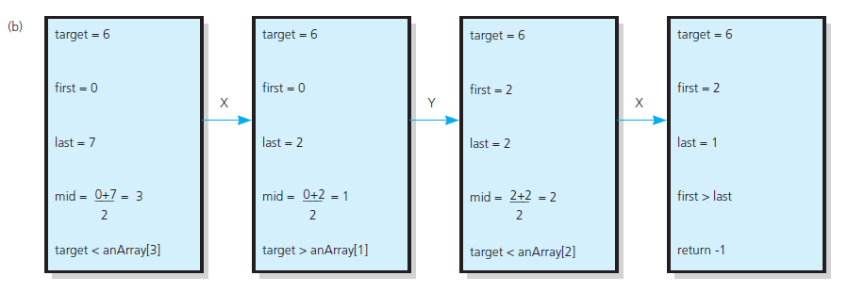
The Binary Search
Box traces of binarySearch with anArray = <1, 5, 9, 12, 15, 21, 29, 31>: (b) an unsuccessful search for 6

Slide 35
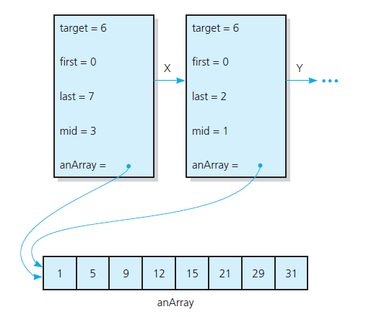
The Binary Search
Box trace with a reference argument

Slide 36
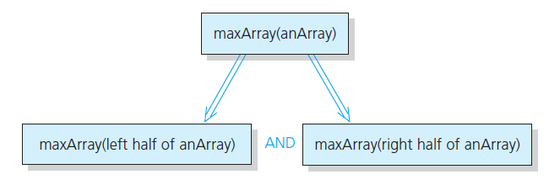
Finding the Largest Value in an Array
Recursive solution to the largest-value problem

Slide 37
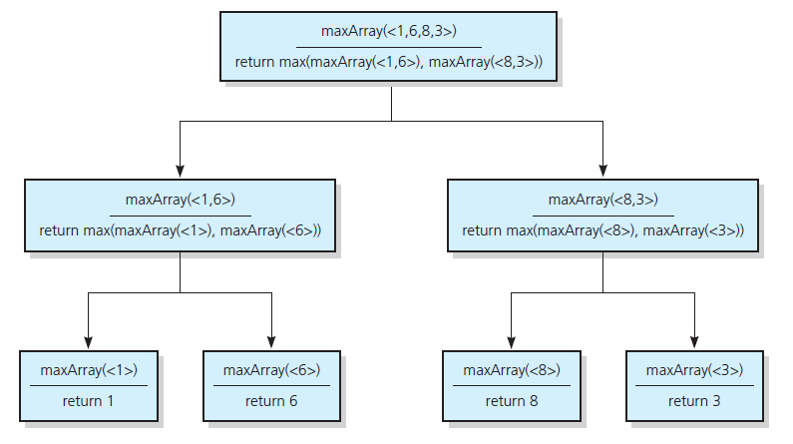
Finding the Largest Value in an Array
FIGURE 2-13 The recursive calls
that maxArray(<1,6,8,3>) generates

Slide 38
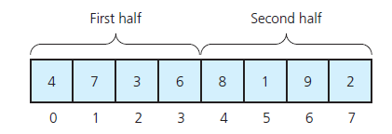
Finding k^{th} Smallest Value of Array
Recursive solution proceeds by:
Selecting pivot value in array
Cleverly arranging/ partitioning values in array about pivot value
Recursively applying strategy to one of partitions
A sample array - a partition about a pivot

Slide 39
Recursion and Efficiency
Factors that contribute to inefficiency
  Overhead associated with function calls
  Some recursive algorithms inherently inefficient
Keep in mind
  Recursion can clarify complex solutions … but …
  Clear, efficient iterative solution may be better

